Slide 1
CENG401 MACHINE LEARNING AND ARTIFICIAL INTELLIGENCE
WEEK-6
MARKOV DESICION PROCESS
Asst.Prof.Dr. Murat ŞİMŞEK

Slide 2
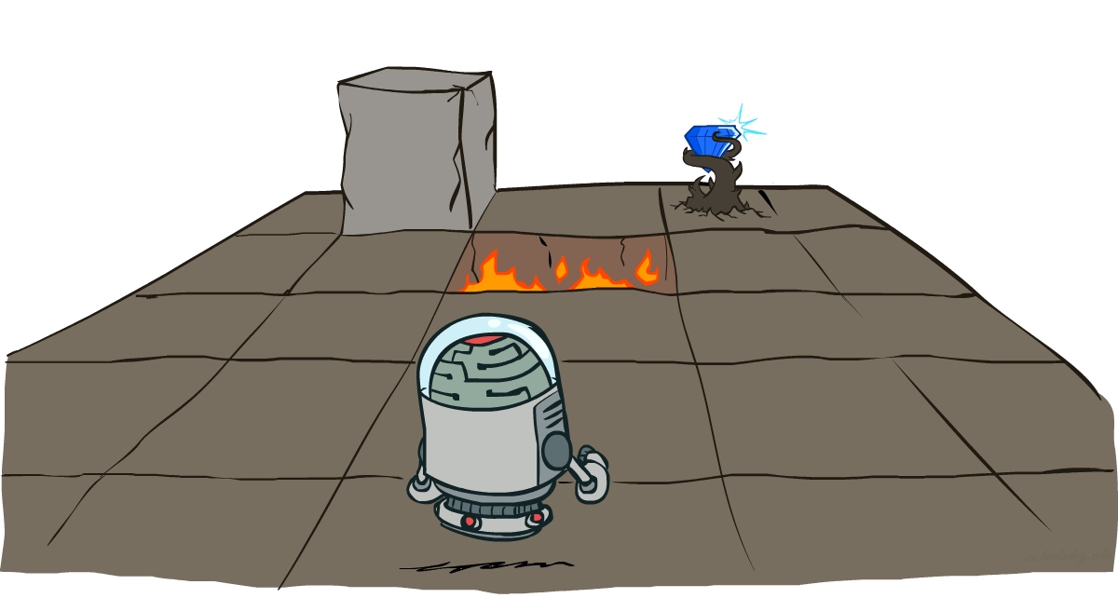
Markov Decision Processes
Notes:
Intelligent agents are supposed to maximize their performance measure.

Slide 3
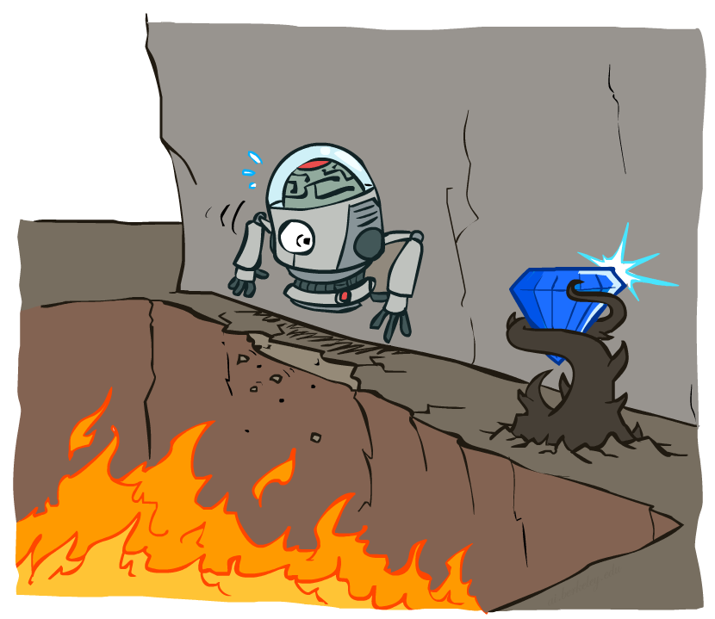
Non-Deterministic Search
Markov decision process (MDP) is a discrete-time stochastic control process. It provides a mathematical framework for modeling decision making in situations where outcomes are partly random and partly under the control of a decision maker.
Notes:
Intelligent agents are supposed to maximize their performance measure.

Slide 4
Solution
First things first, before even starting with MDPs, we’ll quickly glance through the terminology:
Agent: An RL agent is the entity which we are training to make correct decisions (for eg: a Robot that is being trained to move around a house without crashing).
Environment: The environment is the surrounding with which the agent interacts (for eg: the house where the Robot moves). The agent cannot manipulate the environment; it can only control its own actions (for eg: the Robot cannot control where a table is kept in the house, but it can walk around it to avoid crashing).
State: The state defines the current situation of the agent (for eg: it can be the exact position of the Robot in the house, or the alignment of its two legs, or its current posture; it depends on how you address the problem).
Action: The choice that the agent makes at the current time step (for eg: it can move its right or left leg, or raise its arm, or lift an object, turn right or left, etc.). We know the set of actions (decisions) that the agent can perform in advance.
Policy: A policy is the thought process behind picking an action. In practice, it is a probability distribution assigned to the set of actions. Highly rewarding actions will have a high probability and vice versa.

Slide 5





Example: Grid World
A maze-like problem
The agent lives in a grid
Walls block the agent’s path
Noisy movement: actions do not always go as planned
80% of the time, the action North takes the agent North (if there is no wall there)
10% of the time, North takes the agent West; 10% East
If there is a wall in the direction the agent would have been taken, the agent stays put
The agent receives rewards each time step
Small “living” reward each step (can be negative)
Big rewards come at the end (good or bad)
Goal: maximize sum of rewards

Slide 6
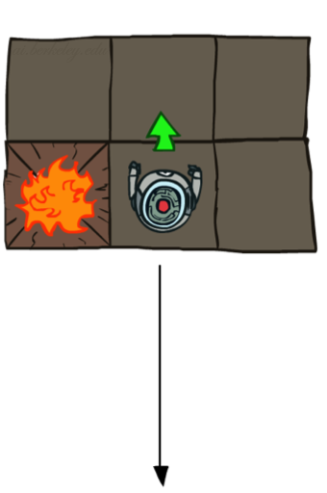
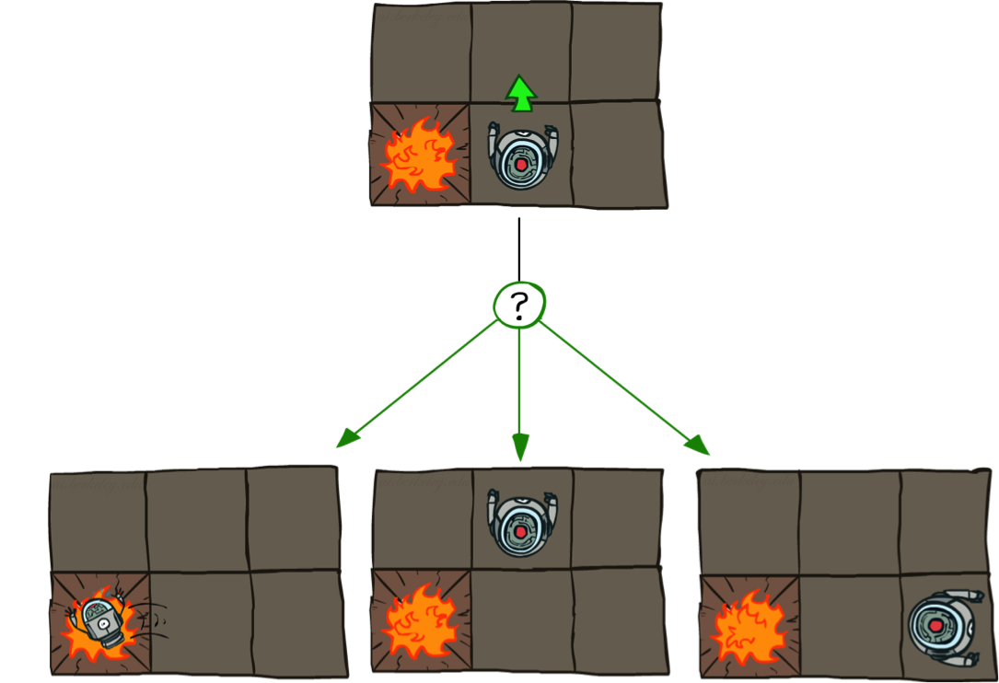

Grid World Actions
Deterministic Grid World
Stochastic Grid World

Slide 7
Markov Decision Processes
Sequential decision problems under uncertainty
Not just the immediate utility, but the longer-term utility as well
Uncertainty in outcomes
Roots in operations research
Also used in economics, communications engineering, ecology, performance modeling and of course, AI!
Also referred to as stochastic dynamic programs
Notes:
In search problems: did not talk about actions, but about successor functions --- now the information inside the successor function is unpacked into actions, transitions and reward
Write out S, A, example entry in T, entry in R
Reward function different from the book : R(s,a,s’)
In book simpler for equations, but not useful for the projects.
Need to modify expectimax a tiny little bit to account for rewards along the way, but that’s something you should be able to do, and so you can already solve MDP’s (not in most efficient way)

Slide 8
Markov Decision Processes
An MDP is defined by:
A set of states s ∈ S
A set of actions a ∈ A
A transition function T(s, a, s’)
Probability that a from s leads to s’, i.e., P(s’| s, a)
Also called the model or the dynamics
A reward function R(s, a, s’)
Sometimes just R(s) or R(s’)
A start state
Maybe a terminal state
MDPs are non-deterministic search problems
One way to solve them is with expectimax search
We’ll have a new tool soon
Notes:
In search problems: did not talk about actions, but about successor functions --- now the information inside the successor function is unpacked into actions, transitions and reward
Write out S, A, example entry in T, entry in R
Reward function different from the book : R(s,a,s’)
In book simpler for equations, but not useful for the projects.
Need to modify expectimax a tiny little bit to account for rewards along the way, but that’s something you should be able to do, and so you can already solve MDP’s (not in most efficient way)

Slide 9
Markov Decision Processes
Defined as a tuple: <S, A, P, R>
S: State
A: Action
P: Transition function
Table P(s’| s, a), prob of s’ given action “a” in state “s”
R: Reward
R(s, a) = cost or reward of taking action a in state s
Choose a sequence of actions (not just one decision or one action)
Utility based on a sequence of decisions
Notes:
In search problems: did not talk about actions, but about successor functions --- now the information inside the successor function is unpacked into actions, transitions and reward
Write out S, A, example entry in T, entry in R
Reward function different from the book : R(s,a,s’)
In book simpler for equations, but not useful for the projects.
Need to modify expectimax a tiny little bit to account for rewards along the way, but that’s something you should be able to do, and so you can already solve MDP’s (not in most efficient way)

Slide 10


What is Markov about MDPs?
“Markov” generally means that given the present state, the future and the past are independent
For Markov decision processes, “Markov” means action outcomes depend only on the current state
This is just like search, where the successor function could only depend on the current state (not the history)
Andrey Markov (1856-1922)
Notes:
Like search: successor function only depended on current state
Can make this happen by stuffing more into the state;
Very similar to search problems: when solving a maze with food pellets, we stored which food pellets were eaten

Slide 11

Example
What SEQUENCE of actions should our agent take?
Reward
+1
1
Each action costs –1/25
Agent can take action N, E, S, W
Faces uncertainty in every state
N
0.8
Blocked
CELL
Reward
-1
2
0.1
0.1
3
1
2
3
4
Start

Slide 12
Solution
S: State of the agent on the grid (4,3)
Note that cell denoted by (x,y)
A: Actions of the agent, i.e., N, E, S, W
P: Transition function
Table P(s’| s, a), prob of s’ given action “a” in state “s”
E.g., P( (4,3) | (3,3), N) = 0.1
E.g., P((3, 2) | (3,3), N) = 0.8
(Robot movement, uncertainty of another agent’s actions,…)
R: Reward (more comments on the reward function later)
R( (3, 3), N) = -1/25
R (4,1) = +1

Slide 13
End of the Week…

